Slide 1


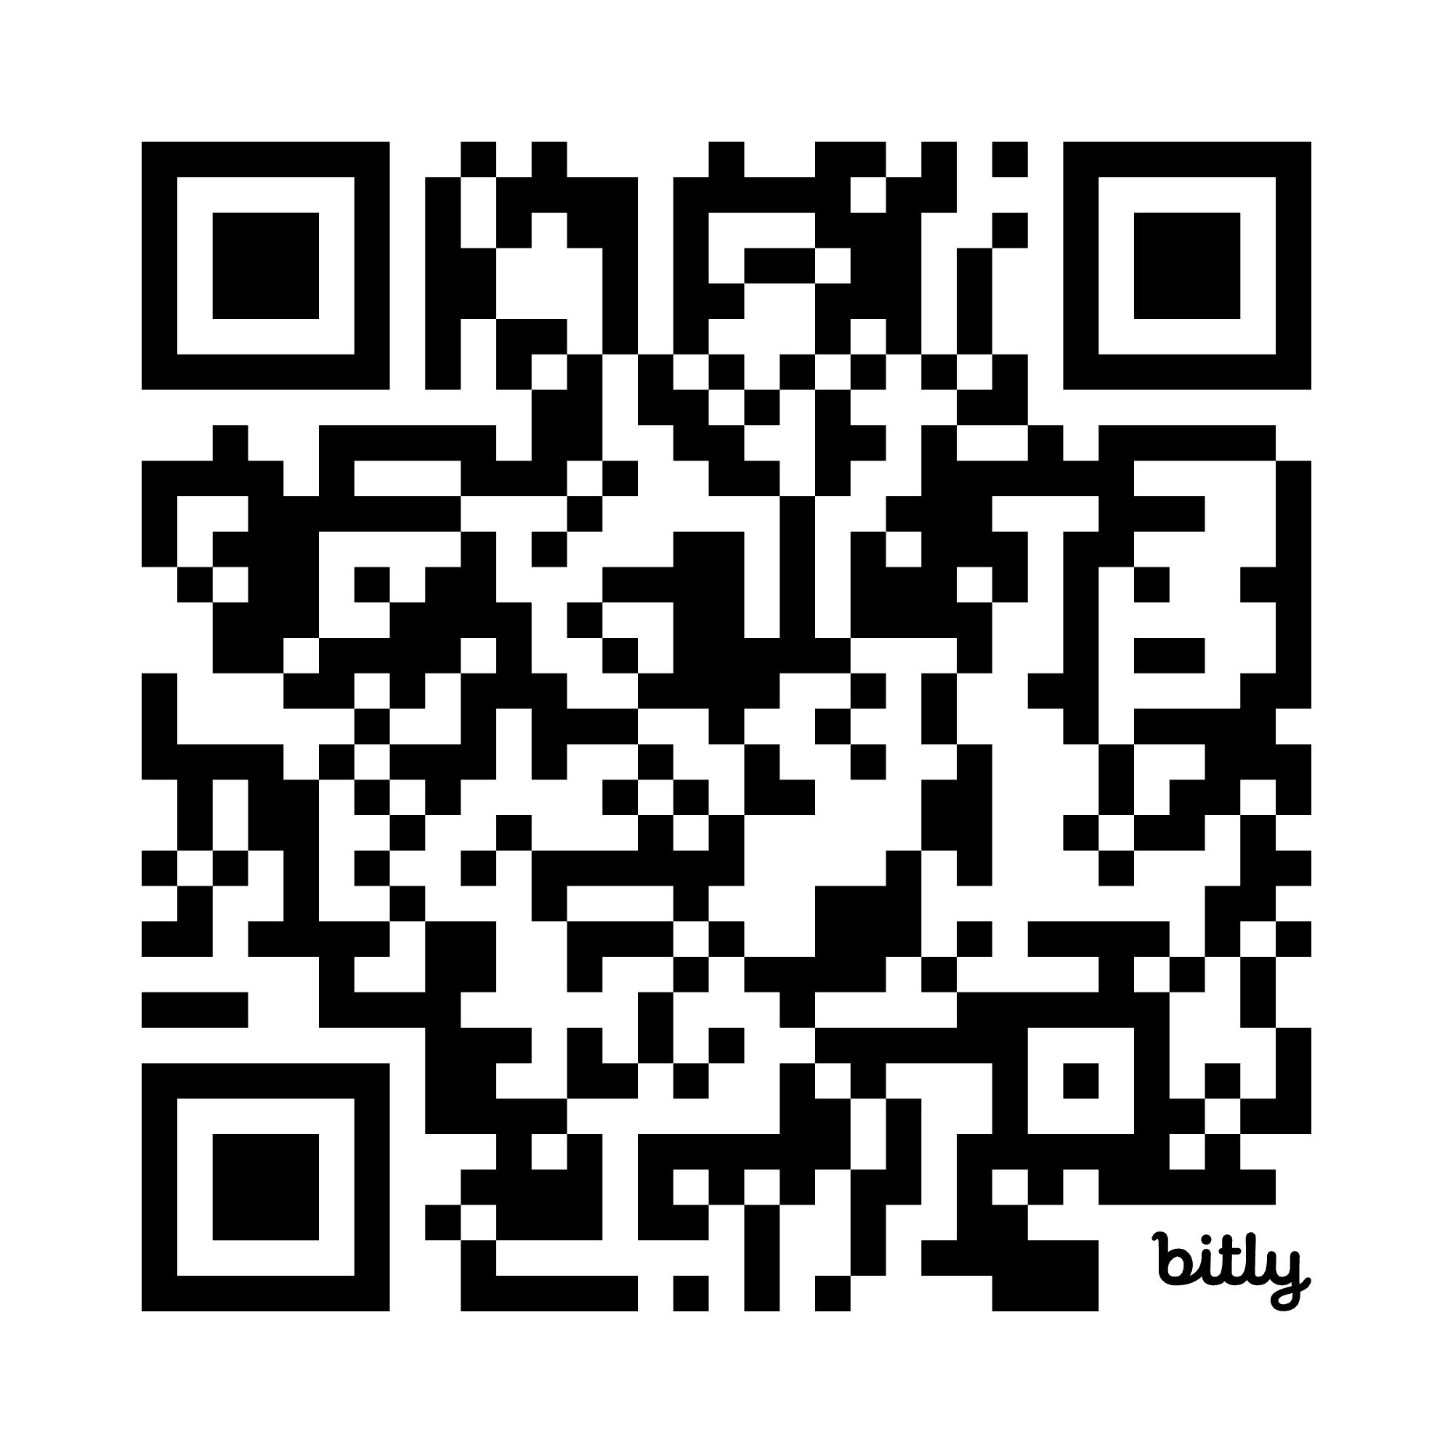
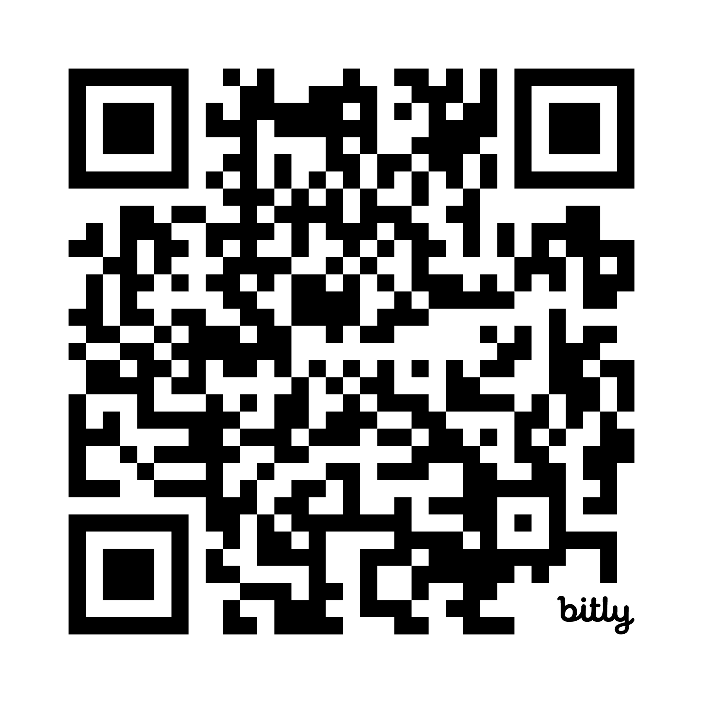
Good scientific writing, and how to achieve it
Kendrick Kay
kay@umn.edu • http://cvnlab.net
Center for Magnetic Resonance Research (CMRR)
University of Minnesota, Twin Cities
These slides:
More information:

Slide 2
Introduction
Scientific writing is a fascinating, complex topic
Why me? What do I know?
I have seen a lot of writing and have collaborated with a lot of people?
I have written a lot of papers?
I am a good writer?
My training is in philosophy where there is an emphasis on clear logic, exposition, and argumentation
Goal of this lecture
Go over and discuss general principles of scientific writing
Of course, listening can get you only so far; next step is to practice
Link to video recording of this talk

Slide 3
What is in scope?
In scope:
Constructing a narrative
Formulating logical organization of thoughts
Converting thoughts into carefully crafted sentences
Conveying ideas clearly
Vocabulary: the right word can make a huge difference
Out of scope:
Syntax, grammar, basic English [that’s a separate topic]

Slide 4


What is scientific writing?
A very specific type of writing (not like e-mail; not like essays you write in school)
Let’s define it as the writing in standard scientific papers (primary research articles, reviews, perspectives, etc.)
Aspects that make scientific writing unique:
Often highly technical
The need to explain complex concepts to a broad audience
Often stereotypical structure (e.g., Introduction, Methods, etc.)
The need to motivate/excite a bored, possibly antagonistic audience
Precision is extremely important

Slide 5
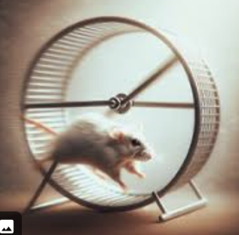
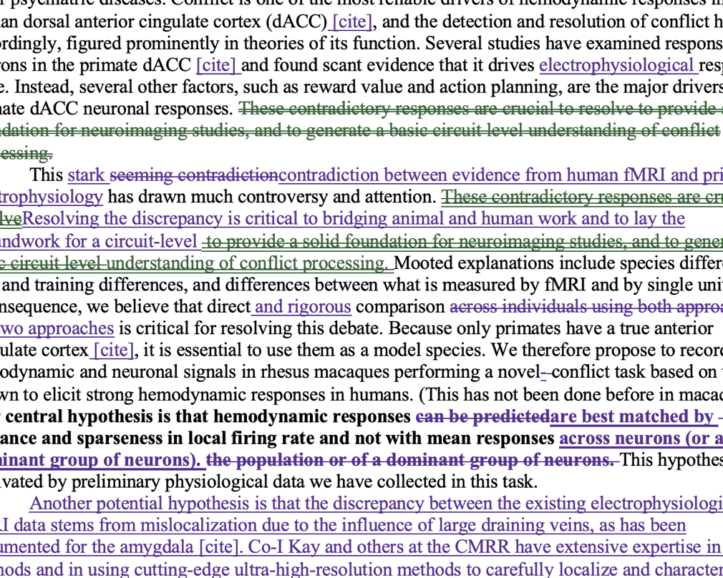
Why is scientific writing hard?
Not very “natural” and not usually formally taught
Principles are usually gained through experience and not typically written down
It is very hard to teach (specialized domain knowledge is necessary to be an effective teacher)
Scientists are busy “doing science” and often don’t have time to focus on improving writing skills per se
Scientific writing is usually collaborative, and collaborative writing is difficult to do well
Scientists often strive to maximize the quality of their writing, and this can take infinite time
(I’m too busy publishing papers!!!!)
(arggg...)

Slide 6
Why is scientific writing hard?
Writing is an optimization problem in a massive space (170000 English words, 7000 words in an article => 170000⁷⁰⁰⁰)
Many criteria to optimize for
Length / brevity
Level of detail
Low-level precision and clarity
High-level narrative and motivation
Many local optima (many ways to write well)
Maybe your writing collaborators have conflicting ideas of what makes good writing?

Slide 7
Why is good scientific writing important?
One might think: “That’s just writing; it’s my results that matter.” => Nope. If your audience can’t understand it, it doesn’t count.
Science is hard enough; don’t let bad writing get in the way
Succeeding in science means making a case for your results, and this is done through writing
If your writing is boring, people will tend to ignore it
You have to excite grant reviewers to get funding
Papers are the primary way that we communicate!

Slide 8
What makes good scientific writing?
“Good” can have many levels, from unreadable to readable-enough-to-get-the-idea to readable-but-not-great to compelling to pristine
Good depends on what the goal is
What is the goal?
To communicate ideas to others (if they can’t explain it back to you, you failed)
To precisely describe your work (can someone reproduce your work based on the writing?)
To convey excitement about your work (if someone doesn’t see why your work is interesting, you failed)

Slide 9
What makes good scientific writing?
Do:
Use consistent terminology
Explain things to the reader
Be concise (less is more)
Agonize about word choice
Tell the reader why you did what you did
Don’t:
Try to impress the reader with your knowledge
Use symbols and jargon as a way of showing off
Use synonyms just to make the words sound fresh
Use big words unnecessarily
Ramble
Make the same point over and over again
Dump a lot of detail/information on the reader without motivation

Slide 10
Hallmarks of bad scientific writing
Not true. (The ideas are just wrong.)
Not clear. (The ideas are presented in a muddled way.)
Poor narrative. (Not clear what the logical relationships between ideas are.)
Incomplete. (Relevant ideas are not provided.)
Bloated. (Too many irrelevant ideas.)
Boring. (Not capturing the reader’s attention.)

Slide 11
Tips for engaging in the act of writing
Scientific writing is a months-long process (a marathon!)
Use mental tricks to self-motivate and avoid writer’s block?
Force yourself to stay on a strict timeline?
Write a little every day?
How to get the words flowing?
Explain it out loud and transcribe what you say
How to fix your words?
Read your writing out loud
Use text-to-speech to reduce fatigue?
Sleep on it and come back with fresh eyes?
Use modern AI tools to help out (e.g. chatGPT)?
Do writing exercises to improve your general skill?
Most importantly, do not prematurely polish your text

Slide 12
General writing process
Take stock of what you have (e.g., results, figures)
Think about overall scope/narrative/audience
Outline, outline, outline (organize your thoughts)
Draft (convert thoughts into basic sentences)
Revise (fine-tune the sentences)
(If you find yourself going in circles or progressing slowly, you are probably doing it wrong!!)

Slide 13
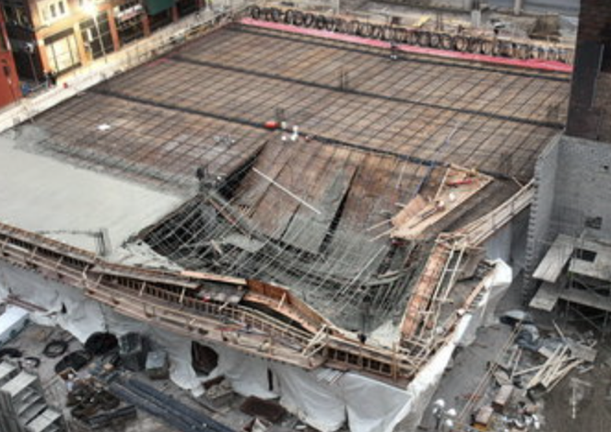
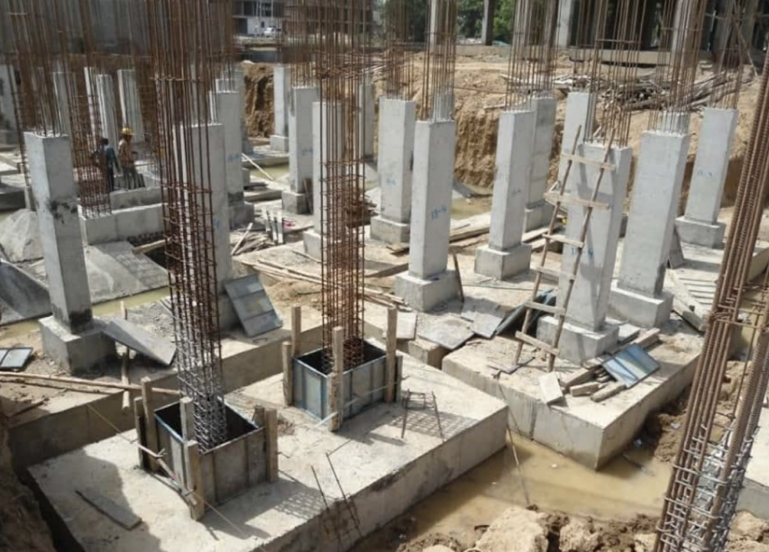
Revising based on feedback
Best to get honest feedback: if your writing is terrible, you need to know. (And the earlier, the better!)
Track changes is, arguably, a terrible, clunky mechanism. The amount of “red text” doesn’t really correlate with the amount of revision a text needs. (Better: interactive editing?)
Common failure mode is text needing a total rewrite if the structural foundations are wrong.
Coarse-to-fine adjustments are most efficient. For example, when I see terrible writing, I don’t edit it, but rather give an overall critique and structural suggestions.
Getting marked-up text does not necessarily teach how to write better. Discussing the rationale and the principles guiding the changes is better. (Is the goal solely to make the text better, or is it to teach the writer how to write?)
vs.

Slide 14
How to learn how to write better?
General writing classes may help to some degree
Having a personalized tutor is probably most helpful?
Learn writing by doing it: practice makes perfect.
There is a clear series of hurdles that must be cleared:
1. Know what is good and what is bad
2. Know why it is bad
3. Know ways of fixing it
4. Get efficient at fixing it
Internalize the writing principles discussed in these slides until they become instinctive!

Slide 15
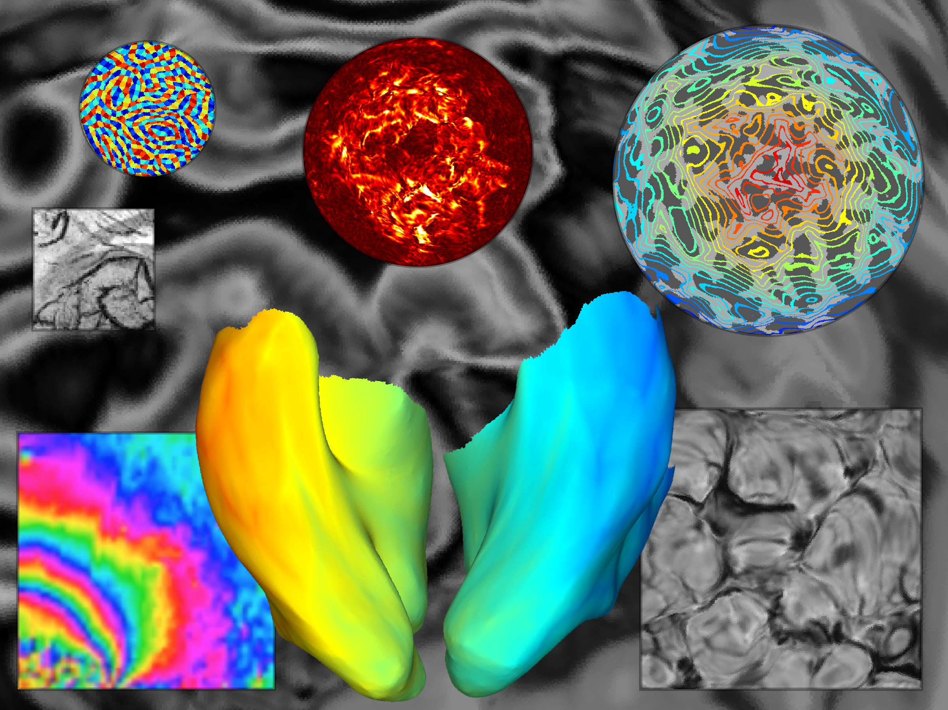
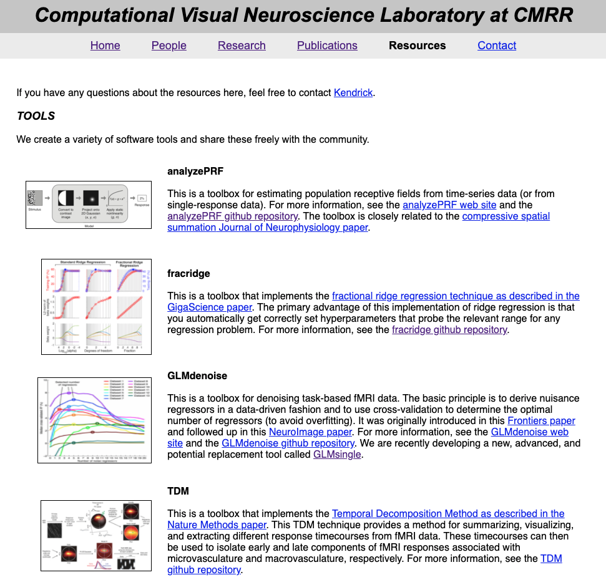

http://cvnlab.net
CODE
DATA

